Slide 1
Dynamic Interaction between Reinforcement Learning and Attention in Multidimensional Environments
Authors：
Yuan Chang Leong, Angela Radulescu,
Reka Daniel, Vivian DeWoskin, Yael Niv
In Brief：
The authors used eye tracking and fMRI to empirically measure fluctuations of attention in a multidimensional decision-making task. The authors demonstrate that decision making in multidimensional environments is facilitated by a bidirectional interaction between attention and trial-and-error reinforcement learning processes.

Slide 2
Introduction
Phenomenon:
Despite the widespread success of RL algorithms in explaining behavior and neural activity on simple learning tasks, these same algorithms become notoriously inefficient as the number of dimensions in the environment increases.
Animals and humans faced with high-dimensional learning problems on a daily basis seem to solve them with ease.
Question:
How do we learn efficiently in complex environments ?
One possibility is to employ selective attention to narrow down the dimensionality of the task.
Attention must be directed toward dimensions of the environment that are important for the task at hand (i.e., dimensions that predict reward) to provide learning processes with a suitable state representation.
we might first have to learn what to attend to.
Hypothesis:
A bidirectional interaction exists between attention and learning in high-dimensional environments.

Slide 3
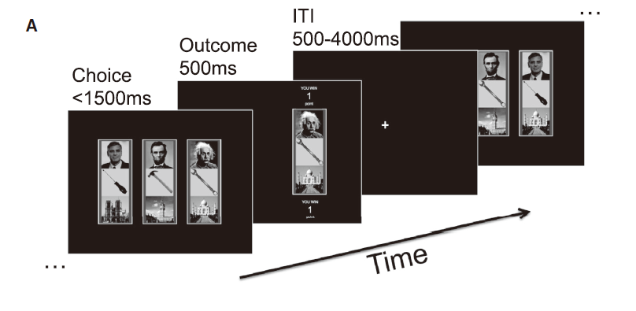
EXPERIMENTAL PROCEDURES
On each trial, participants were presented with three compound stimuli, each defined by a feature on each of the three dimensions (faces, landmarks, and tools), vertically arranged into a column.
In any one game, only one dimension was relevant for predicting reward. Within that dimension, one target feature predicted reward with high probability. If participants chose the stimulus containing the target feature, they had a 0.75 probability of receiving reward. If they chose otherwise, they had a 0.25 probability of receiving reward.
Participants performed four functional runs of the task, each consisting of six games of 25 trials each.
The relevant dimension and target feature changed every 25 trials, and this change was signaled to participants. (New game)

Slide 4
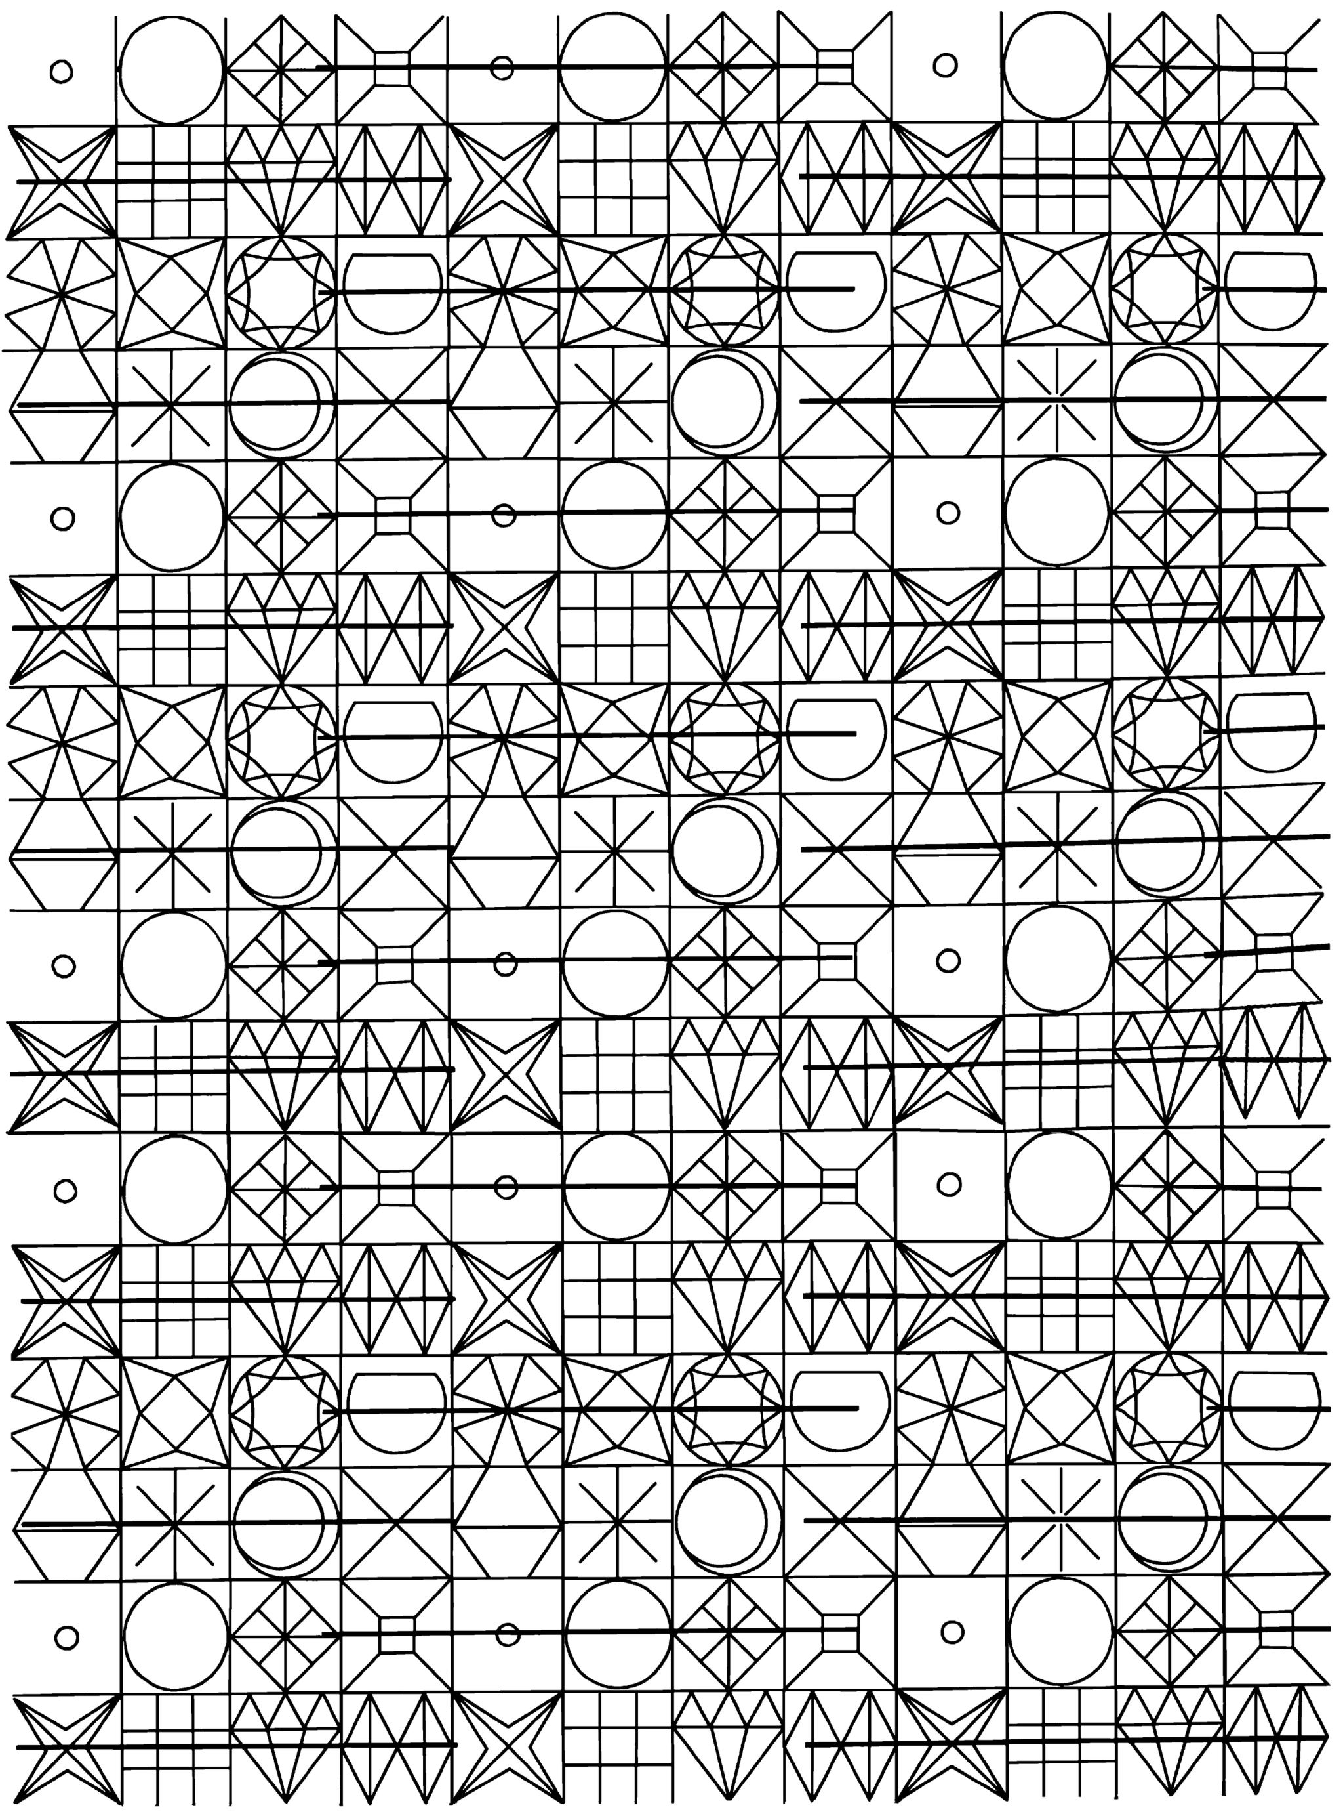
Localizer Task
Using a modified one-back task to identify patterns of fMRI activation in the ventral visual stream that were associated with attention to faces, landmarks, or tools.

Slide 5
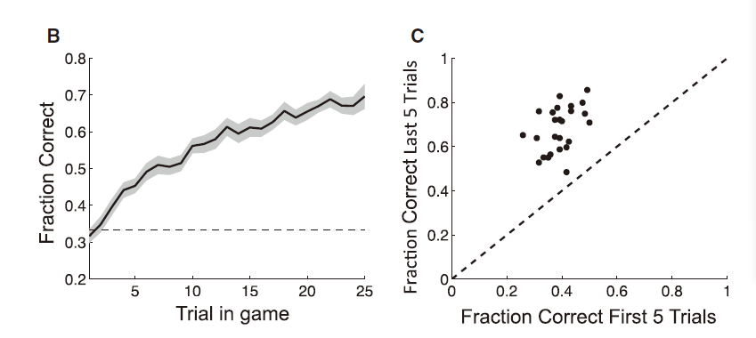
Result
Through trial and error, participants learned to choose the stimulus containing the target feature over the course of a game.
We defined a learned game as one in which participants chose the target feature on every one of the last five trials. By this metric, participants learned on average 11.3 (SE = 0.7) out of 25 games. The number of learned games did not depend on the relevant dimension (F(2,24) = 0.886, p = 0.42).

Slide 6
Attention-Modulated Reinforcement Learning
Two quantitative trial-by-trial measures of participants’ attention to each dimension. (From the eye tracking and MVPA from the fMRI data) ------ Each measure provided a vector of three ‘‘attention weights’’ per trial, denoting the proportion of attention toward each of the dimensions on that trial.
Using their smoothed product as a composite measure of attention on each trial, which we incorporated into different RL models.
Attention can modulate RL in two ways. First, attention can bias choice by differentially weighing features in different dimensions when computing the value of a composite, multidimensional stimulus. Second, attention can bias learning such that the values of features on attended dimensions are updated more as a result of a prediction error.
To test whether and how attention modulated learning in our task, we fit four different RL models to the trial-by-trial choice data.

Slide 7
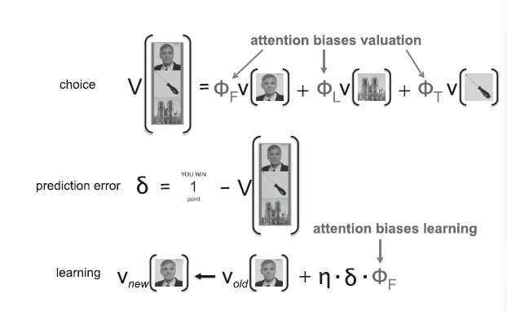
Attention-Modulated Reinforcement Learning
In all four models, we assumed that participants chose between the available stimuli based on their expected value, computed as a linear combination of ‘‘feature values’’ associated with the three features of each stimulus, and that feature values were updated after every trial using a prediction error signal.

Slide 8
Model
In the ‘uniform attention’ (UA) model, all dimensions were weighted equally when computing and updating values. ----- the value of a stimulus was the average values of all its features, and once the outcome of the choice was revealed, the prediction error was equally divided among all features of the chosen stimulus.
In the ‘attention at choice’ (AC) model, the value of each stimulus was computed as a weighted sum of feature values, with attention to the respective dimensions on that trial serving as weights. All dimensions were still weighted equally at learning.
‘Attention at learning’ (AL) model, the update of feature values was differentially weighted by attention; however, all dimensions were equally weighted when computing the value of stimuli for choice.
Finally, the ‘attention at choice and learning’ (ACL) model combined the AC and AL models so that both choice and learning were biased by attention.

Slide 9
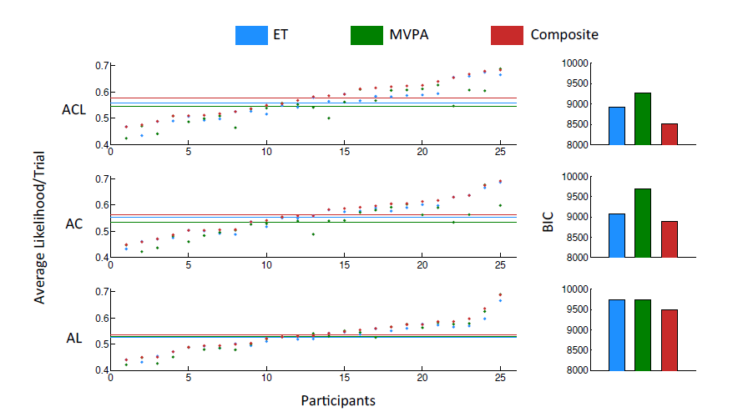
Both Choice and Learning Are Biased by Attention
Model comparison
To assess how well the models explained participants’ behavior, we used a leave-one-game-out cross-validation procedure to compute the likelihood per choice for each participant.
The higher the average choice likelihood, the better the model predicted the data of that participant. we computed the Bayesian information criterion (BIC; Schwarz, 1978) for each model.
In all cases, using the composite attention measure provided a better fit to the data than if we used the MVPA measure or the eye-tracking measure alone.

Slide 10
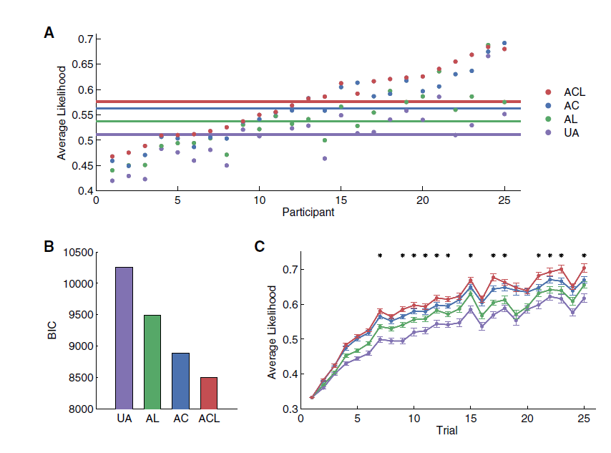
Both Choice and Learning Are Biased by Attention
Result:
Both model-performance metrics showed that the ACL model, in which attention modulated both choice and learning, outperformed the other three models.
A: Average likelihood per trial for the ACL model was highest for 21 of 25 subjects, on average significantly higher than that for the AC (t24 = 4.72, p < 0.001), AL (t24 = 6.70, p < 0.001), and UA (t24 = 8.61, p < 0.001) models. Both the AC and AL models also yielded significantly higher average likelihood per trial than the UA model (AC: t24 = 8.03, p < 0.001; AL: t24 = 7.20, p < 0.001).
B: Model comparison using BIC confirmed that the ACL model has the lowest (i.e., best) BIC score.
C: The average likelihood per trial of the ACL model diverged significantly from that of the other models early in the game, when performance was still well below asymptote.

Slide 11
Both Choice and Learning Are Biased by Attention
Conclusion:
These results suggest that attention processes biased both how values were computed during choice and how values were updated during learning.
Notably, the partial attention models (AC and AL) also explained participants’ behavior better than the model that assumed uniform attention across dimensions (UA), providing additional support for the role of attention in participants’ learning and decision-making processes.

Slide 12
Eye tracking/MVPA
Eye tracking:
1. A horizontal rectangular area of interest (AOI) was defined around each horizontal dimension in the visual display.
2. preprocessing--reduce high-frequency noise, discarding data from the first 200 ms after the onset of each trial
3. taking the proportion of time participants’ point of gaze resided within each AOI as a measure of attention to the corresponding dimension.
4. To account for subject-specific noise, we computed a weighted sum between the raw measure and uniform attention (one-third to each dimension). The weight Wet, which served to smoothly interpolate between uniform attention and the empirical eye-tracking measure, was a free parameter fit to each subject’s behavioral data.
5. As Wet decreased, the empirical measure contributed less to the final attention vector.

Slide 13
Eye tracking/MVPA
MVPA:
A linear support vector machine (SVM) was trained on data from the localizer task to classify the dimension that participants were attending to on each trial based on patterns of BOLD activity. (SVM for face vs not face and ……)
Analysis was restricted to voxels in a ventral visual stream mask consisting of the bilateral occipital lobe and ventral temporal cortex.
On each trial, the classifier returned the probability that the participant was attending to each of the dimensions (three numbers summing to 1).
Similar to the eye-tracking measure of attention, we computed a weighted sum between the probabilities and uniformly distribution attention.
Wu, T.-F., Lin, C.-J., and Weng, R.C. (2004). Probability Estimates for Multi-class Classification by Pairwise Coupling. J. Mach. Learn. Res. 5, 975–1005.

Slide 14
Composite Measure
Composite Measure:
To combine the two measures of attention, we computed a composite measure as the product of eye-tracking and MVPA measures of attention, renormalized to sum to 1.

Slide 15




Choice Models
Equation1:
Equation2:
Equation3:
Equation4:

Slide 16
Choice Models
The three attention models (ACL, AL, and AC) had four free parameters ---- WMVPA, WET, Beta, learning rate. The uniform attention model had two free parameters -----Beta, learning rate.
Model comparison used a leave-one-game-out cross-validation procedure: for each participant and for each game, they fit the model to participants’ choices from all other games by minimizing the negative log likelihood of the choices. Given these parameters, we then calculated the likelihood of each choice in the held-out game.

Slide 17
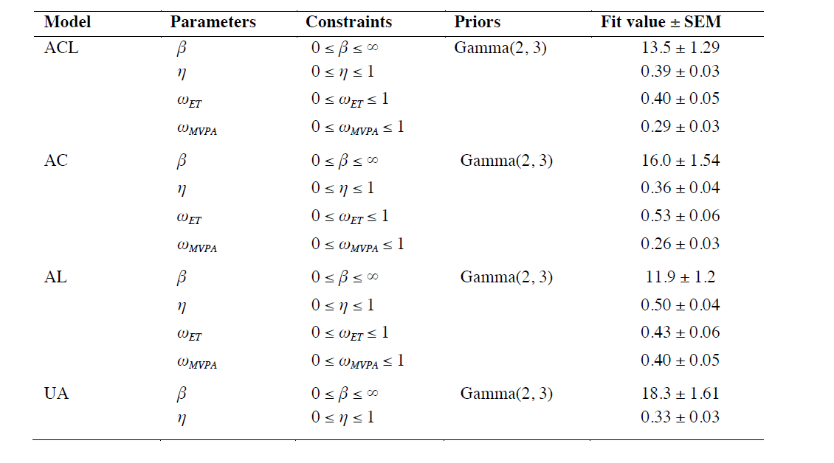
Best-fit model parameters

Slide 18
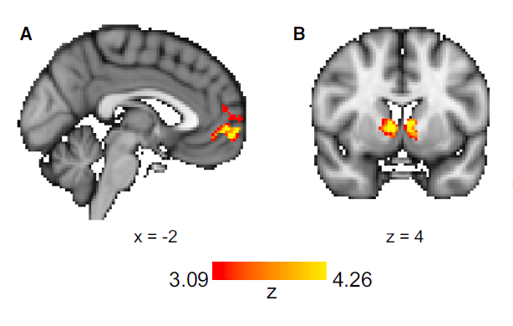
Neural Value Signals and Reward Prediction Errors Are Biased by Attention
To test which model was most consistent with the neural value representation, we entered the trial-by-trial value estimates of the chosen stimulus generated by all four models into a single GLM(GLM1). This allowed us to search the whole brain for clusters of brain activity whose variance was uniquely explained by one of the models while simultaneously controlling for the value estimates of the other models.
Results showed that activity in the vmPFC was significantly correlated with the value estimates of the ACL model, suggesting that the computation and update of the value representation in vmPFC was biased by attention.

Slide 19
Neural Value Signals and Reward Prediction Errors Are Biased by Attention
Testing whether neural prediction error signals were also biased by attention. For this, we entered trial-by-trial prediction error regressors generated by each of the four models into a single whole-brain GLM(GLM2). Prediction errors generated by the ACL model were significantly correlated with activity in the striatum, the area most commonly associated with prediction error signals in fMRI studies.
Conclusion:
These results provide neural evidence that attention biases both the computation of subjective value as well as the prediction errors that drive the updating of those values.

Slide 20
GLM1/GLM2
GLM1: For each participant, we generated estimates for the expected value of the chosen stimulus on each trial using the UA, AC, AL, and ACL models. We entered these value estimates into the GLM as parametric modulators of the stimulus onset regressor. GLM1 could therefore identify regions that are associated with the value estimates of each model, while simultaneously controlling for the value estimates of the other models.
GLM2: The GLM2 was identical to GLM1 except that instead of generating estimates of expected values, we generated estimates of trial-by- trial prediction errors using the four models and entered them into the GLM as parametric modulators of the outcome onset regressor.

Slide 21

Attention Is Modulated by Value and Reward
Goal:
Examining how learning modulates attention.
As a measure of participants’ attention bias : the standard deviation (SD) of the three attention weights on each trial. Low SD corresponded to relatively uniform attention, while high SD implied that attention was more strongly directed to a subset of dimensions.

Slide 22
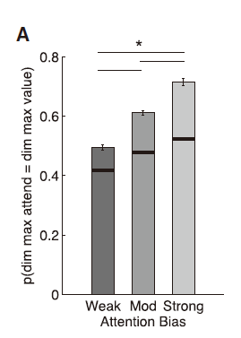
Attention Is Modulated by Value and Reward
According to the attention bias, they spilt three subset : weak, moderate and strong.
Method: bootstrapping
Result:
the most strongly attended dimension was often also the dimension with the feature of highest value, suggesting that attention was often directed toward aspects of the stimuli that had acquired high value.

Slide 23
Bootstrap
Attention weights for each game of each participant were replaced with those of a randomly selected game from the same participant.
The ACL model was then run using these attention weights to generate estimates of feature values from participants’ actual choices and outcomes, creating a “fictitious” dataset.
This process was repeated 1000 times, and a null distribution of t-statistics was generated for each pairwise comparison by performing the corresponding paired t-test on each iteration of the fictitious dataset. p-values were then determined by comparing the t-statistic obtained from the unshuffled data to the corresponding null distribution for that comparison.

Slide 24
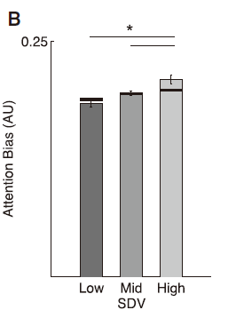
Attention Is Modulated by Value and Reward
Result:
A tercile split of each participant’s data based on the standard deviation of the values (SDV) of the highest-valued feature in each dimension, a measure of the difference in feature values across dimensions. Attention bias was stronger on high SDV trials than on middle and low SDV trials.
These results suggest that learned values modulated where participants attended to and the strength of their attention bias.

Slide 25
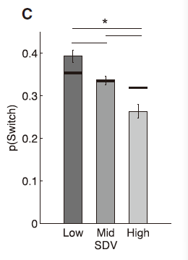
Attention Is Modulated by Value and Reward
Hypothesis:
Attention switches would be more likely when feature values were similar across dimensions.
An attention switch as a change in the maximally attended dimension.
Attention measurements suggested that participants switched their focus of attention on approximately one-third of the trials. Switches were more frequent on low SDV trials than on and high SDV trials. Switches were also more frequent on middle SDV trials than on high SDV trials.

Slide 26
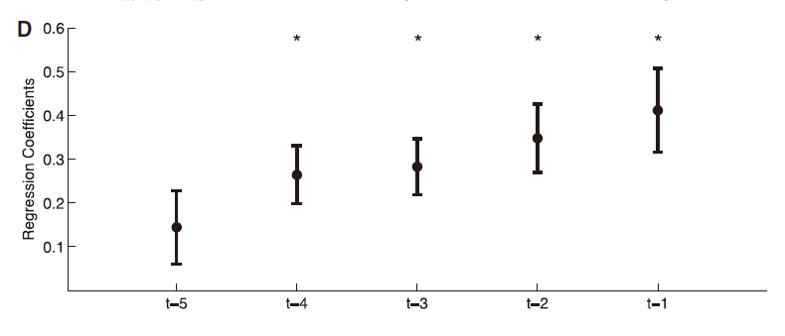
Attention Is Modulated by Value and Reward
To determine the influence of recent reward on attention switches, they ran a logistic regression predicting attention switches from outcome (reward versus no reward) on the preceding five trials.
Result:
Absence of reward in previous trials was a significant predictor of attention switches on the current trial t, with regression coefficients decreasing and no longer significantly different from zero at trial t-5.
Conclusion:
Participants were more likely to switch their focus of attention after a string of no reward, and feedback on more recent trials had a greater influence than trials further back in the past

Slide 27
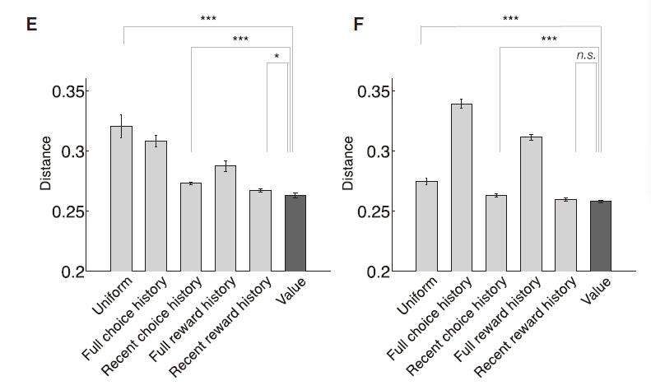
Attention Is Modulated by Value and Reward
Model based analysis：
They tested that attention allocation could be better explained by choice history (i.e., attention was enhanced for features that have been previously chosen), reward history (i.e., attention was enhanced for features that had been previously rewarded), or learned value (i.e., attention was enhanced for features associated with higher value over the course of a game).
Cross-validated model comparison revealed that the empirical attention data were best explained by a model that tracked feature values.

Slide 28
Attention Is Modulated by Value and Reward----6 model
The ‘‘Full Choice History’’ model allocated attention based on a leaky choice count. On each trial, counts for each of the three chosen features were incremented by 1, and counts for the remaining six unchosen features were decayed toward 0 at a subject-specific decay rate. Attention to each dimension was then determined by the softmax of the maximal count on each dimension.
The ‘‘Recent Choice History’’ model used a delta-rule update to adjust the weights of the chosen features toward 1. Equation: Chosen: Wt+1=Wt + n(1-Wt). Unchosen decay to 0 and softmax to determine the attention weight.
The ‘‘Full Reward History’’ model allocated attention based on a leaky reward count. Similar with first model, but just for reward trial. No learning or decay occurred on unrewarded trials.
The ‘‘Recent Reward History’’ model, just for reward trial, same as the model 2.
The ‘value’ model, The value of each stimulus was assumed to be the sum of the values of all its features. Feature values were initialized at 0 and updated via reinforcement learning with decay. on each trial, a prediction error was calculated as the difference between the obtained reward and the value of the chosen stimulus. The value of chosen features was updated based on the prediction error scaled by a subject-specific update rate, while the value of unchosen features was decayed toward 0 at a subject-specific decay rate.
The ‘uniform’ model, all time (1/3,1/3,1/3).
In sum, the Full Choice and Recent Choice models allocated attention based on prior choices, whereas in the Full Reward, Recent Reward, and Value models, the history of reinforcement determined fluctuations in attention.

Slide 29
Attention Is Modulated by Value and Reward----6 model
The Full Choice and Full Reward models had two free parameters — decay rate and softmax gain. Other three added the update rate.
root-mean-square deviation (RMSD).
Using leave-one-game-out cross-validation to determine parameters and get the final RMSD for each model.
Fit the model with Eye tracking data/MVPA/composite measure.

Slide 30
Attention Is Modulated by Value and Reward
Result:
In particular, the ‘‘Value’’ model outperformed the next-best ‘‘Recent Reward History’’ model for both the eye-tracking and composite measure.
For the MVPA data, the Value model did not significantly improve upon the predictions of the Recent Reward History model, however, it still performed significantly better than the ‘‘Recent Choice History’’ model.

Slide 31
Attention Is Modulated by Value and Reward
Conclusion:
In summary, both model-based and model-free results suggest that attention was dynamically modulated by ongoing learning. As participants learned to associate value with features over the course of a game, attention was directed toward dimensions with features that acquired high value. The greater the feature values in a dimension, the stronger the attention bias was toward that dimension. Conversely, when feature values across dimensions were similar, attention was less focused and switches between dimensions were more likely. Finally, attention was better explained as a function of learned value rather than simpler models of reward or choice history.

Slide 32
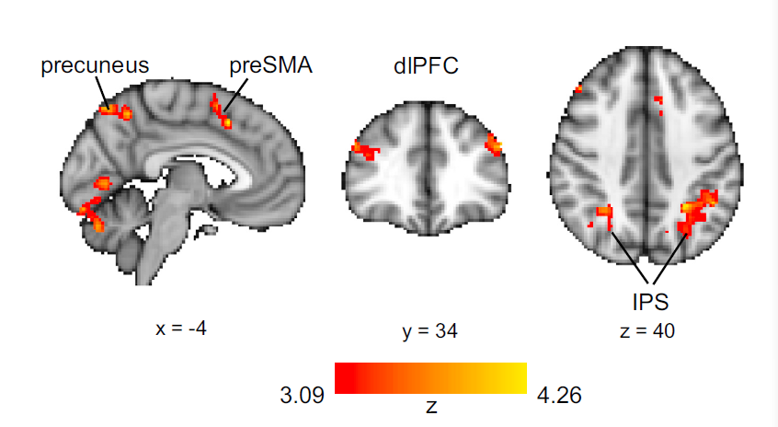
Attention Switches Correlate with Activity in a Frontoparietal Control Network
A contrast searching for more activity on switch rather than stay trials showed clusters in the dorsolateral prefrontal cortex (dlPFC), intraparietal sulcus (IPS), frontal eye fields (FEF), pre supplementary motor area (preSMA), precuneus, and fusiform gyrus. These brain regions are part of a frontoparietal network that has been implicated in the executive control of attention.
This attentional control system also supports top-down allocation of attention during learning and decision making in multidimensional environments. (GLM3)

Slide 33
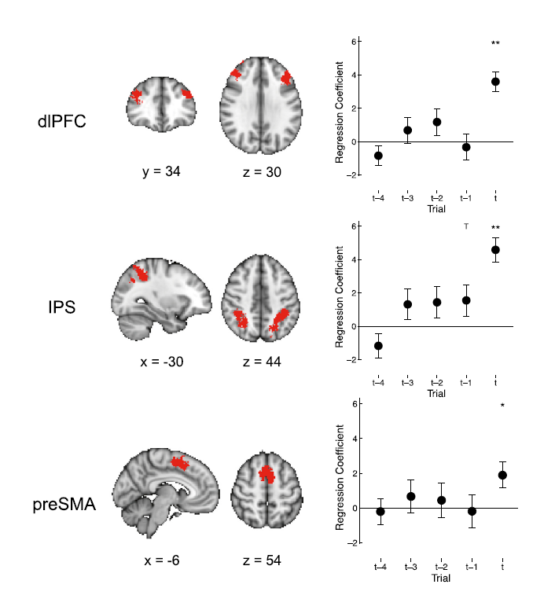
Attention Switches Correlate with Activity in a Frontoparietal Control Network
Question:
whether this network was activated only by attention switches.
Test:
Define ROI in the dlPFC, IPS, and preSMA. For each ROI, they extracted the mean time course during each run and modeled these data using a GLM with regressors for attention switch trials, as well as four trials preceding each switch. (GLM4)
Result:
In all three ROIs, we found that activity increased only on attention-switch trials and not the trials preceding them, suggesting that this network was involved in switching attention rather than accumulating evidence for the switch.

Slide 34

GLM3/GLM4
GLM3: GLM3 modeled switch and stay trials as stick functions at the onset of the respective trials. We defined switch trials as trials in which the maximally attended dimension was different from the previous trial and all the rest as stay trials. A contrast identified clusters that were more active during switch versus stay trials.
GLM4: GLM4 included one regressor with stick functions at the onset of all switch trials, another with stick functions at the onset of all trials immediately preceding a switch trial, and so forth for the four trials preceding each switch, totaling to five trial-onset regressors.

Slide 35
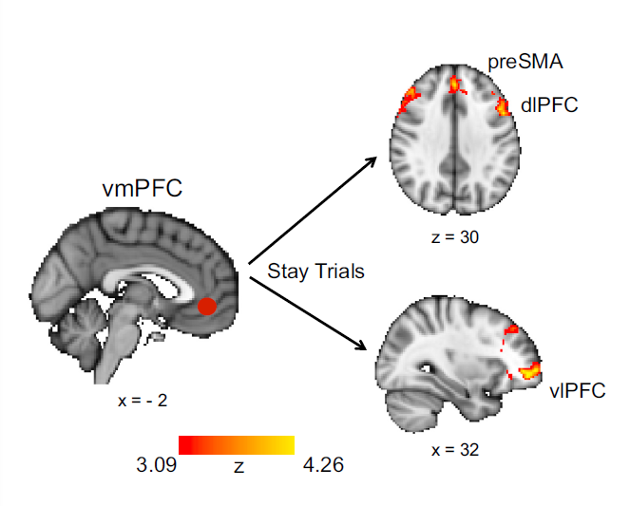
Enhanced Functional Connectivity between vmPFC and Frontoparietal Network between Switches
A psychophysiological interaction (PPI) analysis that searched for brain areas that exhibit enhanced functional connectivity with the vmPFC that is specific to switch trials or to stay trials.
This showed that connectivity between parts of the frontoparietal attention network and vmPFC differed according to whether participants switched attention on the current trial or not: bilateral dlPFC and preSMA were significantly anti-correlated with vmPFC on stay trials, above and beyond the baseline functional connectivity between these regions.
This suggests that as value signaled by the vmPFC increased, activity in the dlPFC and preSMA decreased, reducing the tendency to switch attention between task dimensions .

Slide 36
Thanks

